Slide 1
Weekly Report
程文胜 2021.4.27-5.3

Slide 2
Weekly Report
Abstract
Content
End

Slide 3
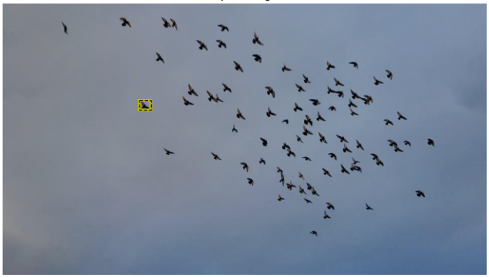
Abstract
Last week I mainly spent time on thinking about related fields, and trying the few-shot counting paper of Prof. Minh.

Slide 4
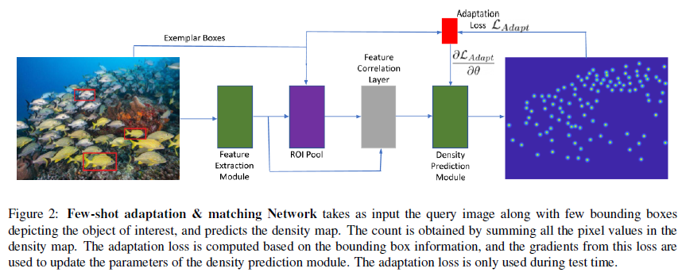
Content
The problem studied in the few shot counting paper is very similar with our one-shot task, except it only cares about the density, not the precise bounding box, and the exemplar objects could be more than one.

Slide 5
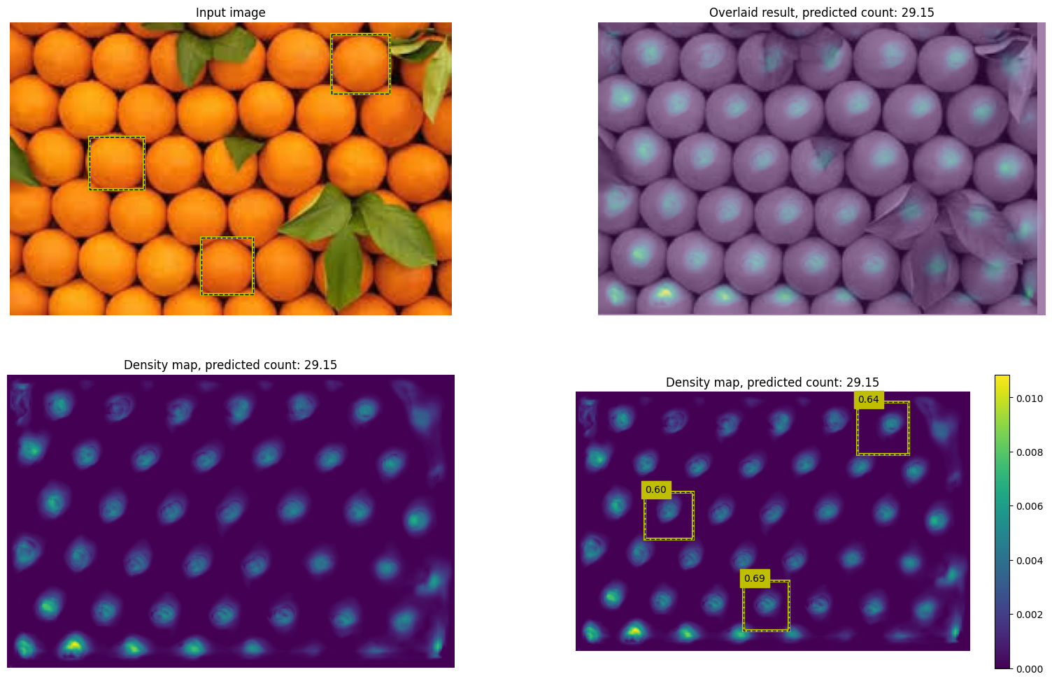
Content

Slide 6
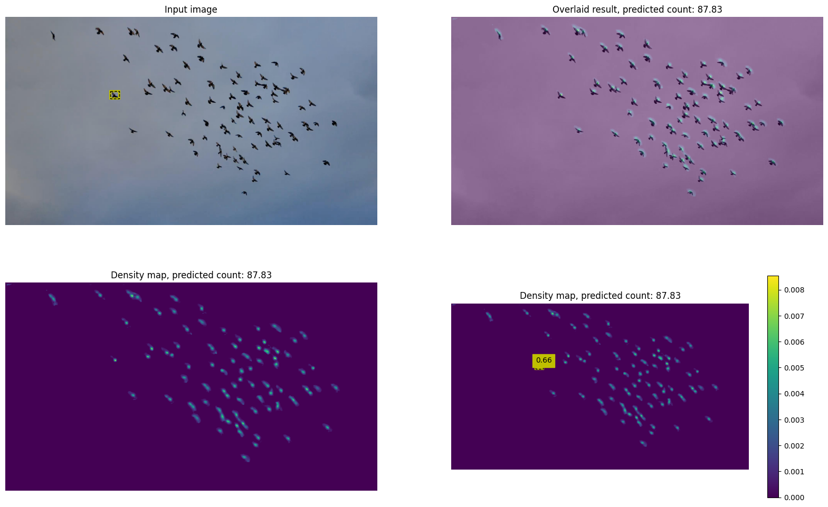
Content
When the background is clean, e.g., the sky, the result seems good.

Slide 7
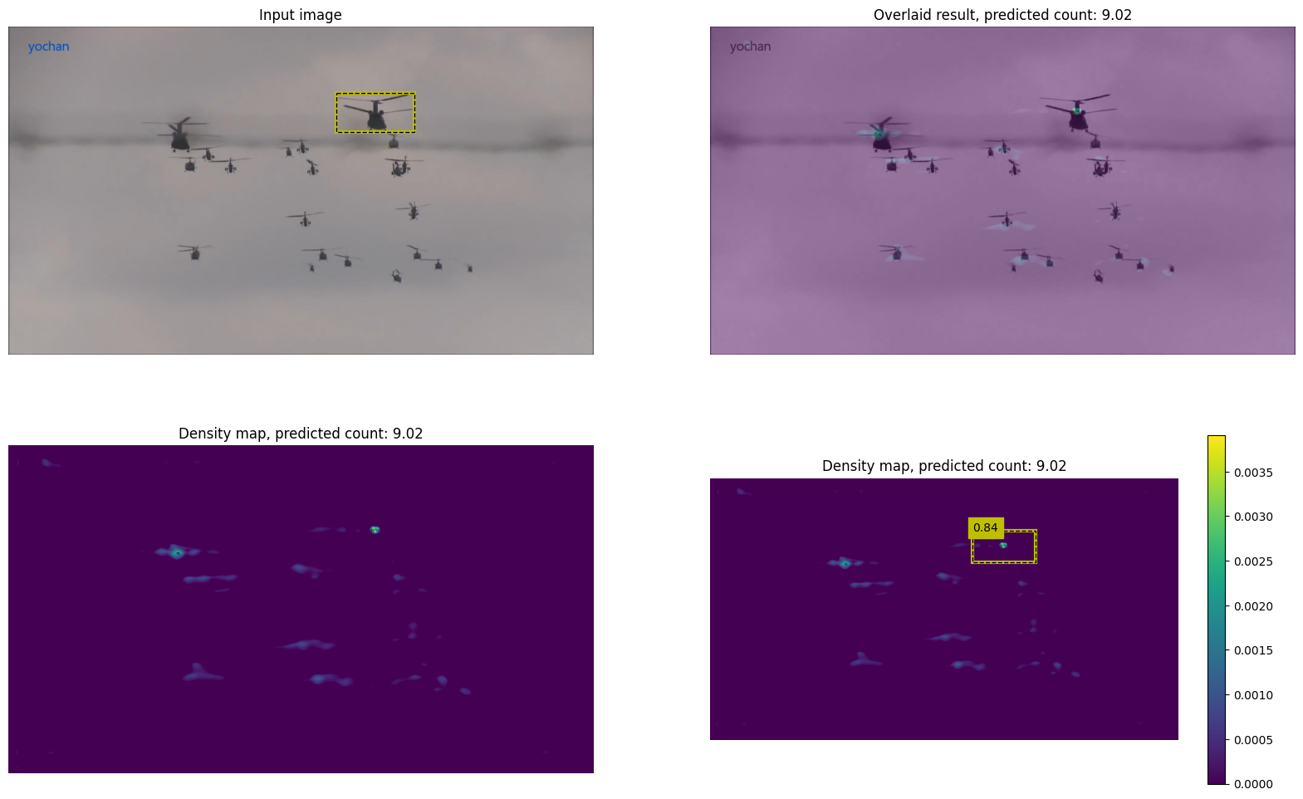
Content
When the background is clean, e.g., the sky, the result seems good.

Slide 8
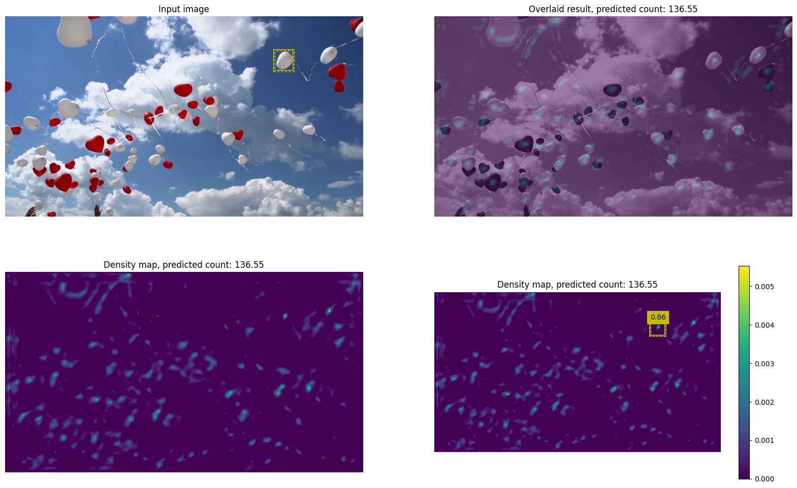
Content
But when background becomes complex, there would be many false positives.

Slide 9
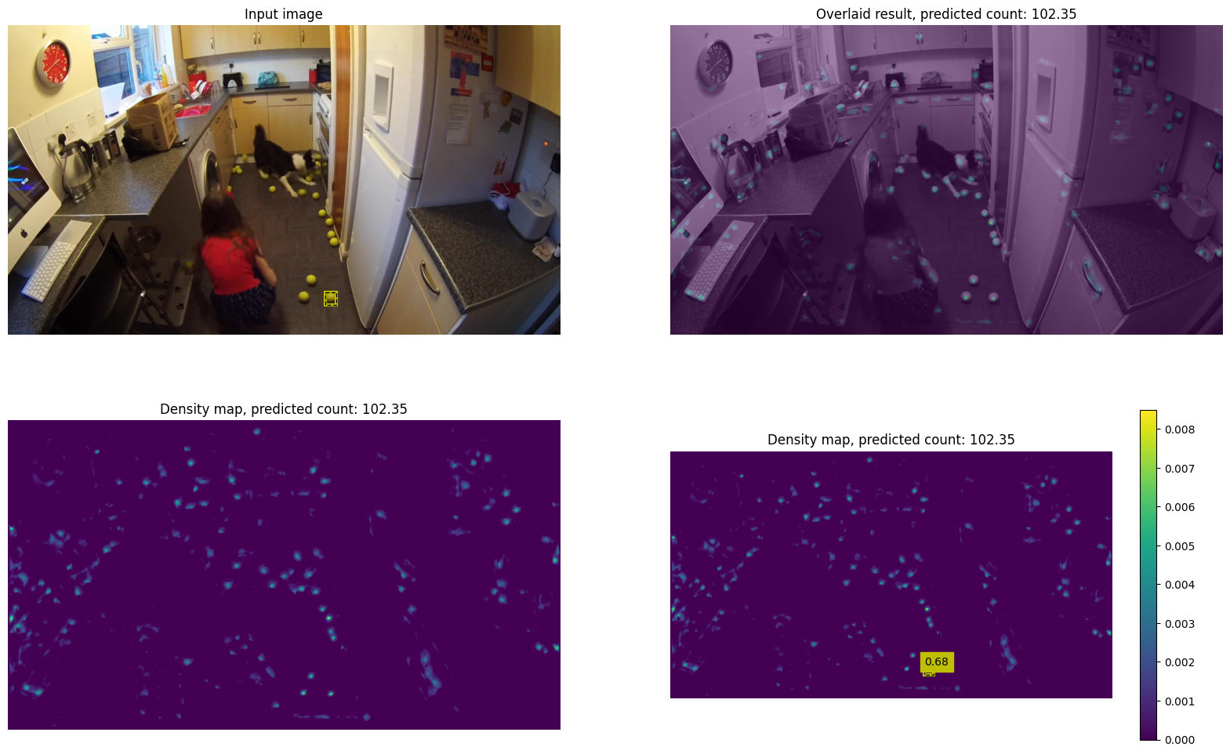
Content
But when background becomes complex, there would be many false positives.

Slide 10
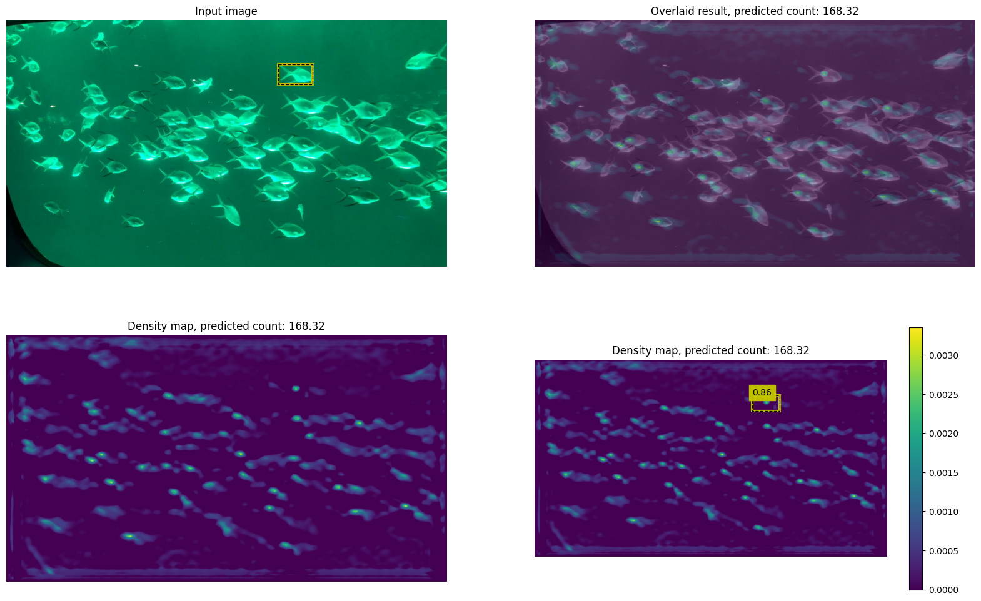
Content
But when background becomes complex, there would be many false positives.

Slide 11
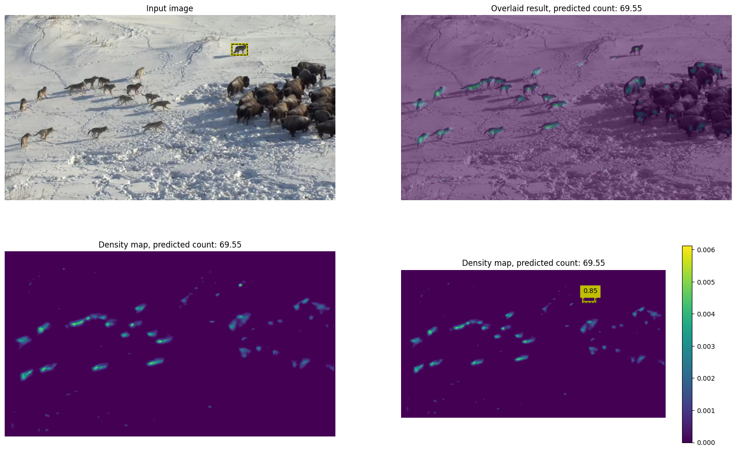
Content
I also tried adding more shots to the model when testing.

Slide 12

Content
I also tried adding more shots to the model when testing.

Slide 13
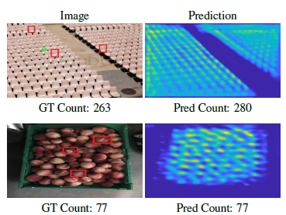
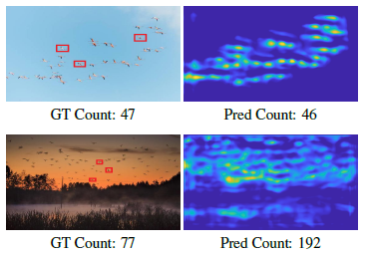
Content
I plan to check the method in detail for next week, and tried to adjust it for our task.

Slide 14

Content
Framework. Last week I spent much time on thinking about framework, does it refer to the problem formulation, like take it as a one-shot object detection task, or a specific method?

Slide 15
Report End
程文胜 5.3

